Slide 1
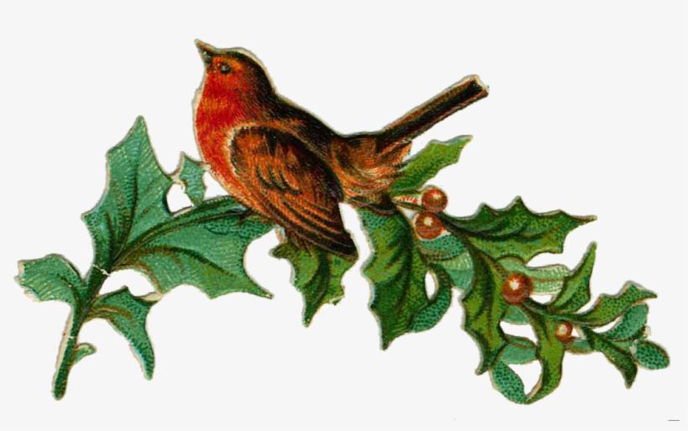
Family Christmas
REMNANT
CHURCH
#AwkwardFamilyChristmas

Slide 2
@JerryGodsey
#TwoKindsOfSeekers
Two Kinds of Seekers
REMNANT
CHURCH
#AwkwardFamilyChristmas

Slide 3
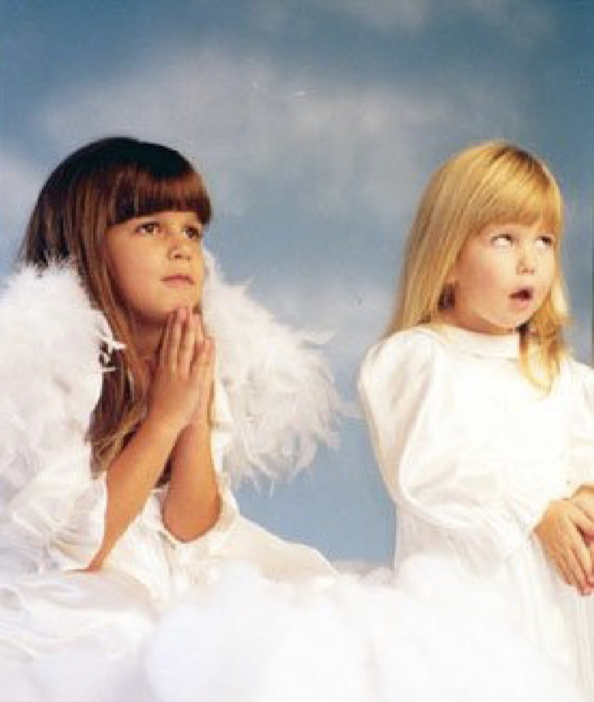
@JerryGodsey
#TwoKindsOfSeekers
Two Kinds of Seekers
REMNANT
CHURCH
#AwkwardFamilyChristmas

Slide 4
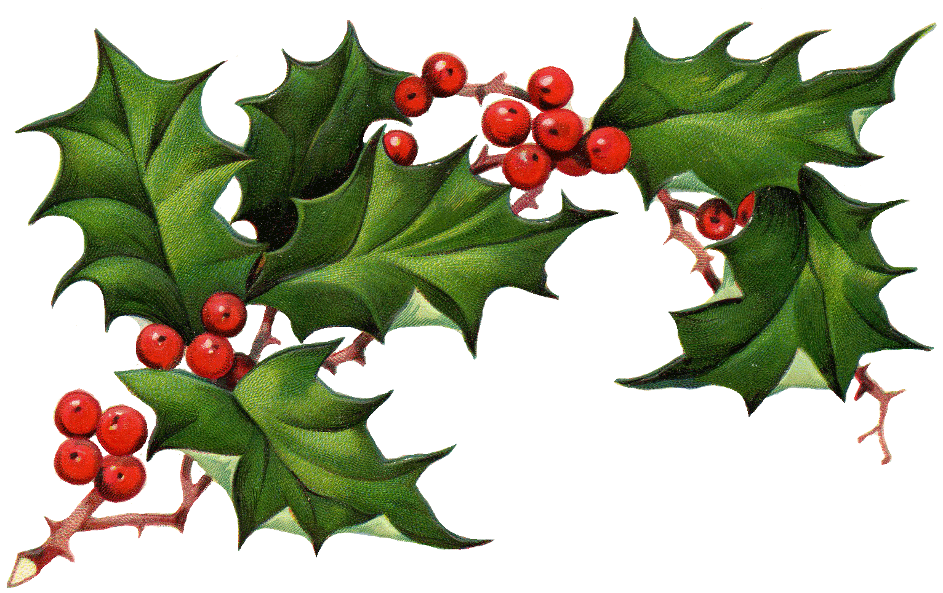
@JerryGodsey
#TwoKindsOfSeekers
Matthew 2:1-12
Jesus was born in Bethlehem in Judea, during the reign of King Herod. About that time some wise men from eastern lands arrived in Jerusalem, asking, ² “Where is the newborn king of the Jews? We saw his star as it rose, and we have come to worship him.”
³ King Herod was deeply disturbed when he heard this, as was everyone in Jerusalem.
REMNANT
CHURCH
#AwkwardFamilyChristmas

Slide 5
@JerryGodsey
#TwoKindsOfSeekers
Matthew 2:1-12
⁴ He called a meeting of the leading priests and teachers of religious law and asked, “Where is the Messiah supposed to be born?”
⁵ “In Bethlehem in Judea,” they said, “for this is what the prophet wrote:
⁶ ‘And you, O Bethlehem in the land of Judah,
are not least among the ruling cities of Judah,
for a ruler will come from you
REMNANT
CHURCH
#AwkwardFamilyChristmas

Slide 6
@JerryGodsey
#TwoKindsOfSeekers
Matthew 2:1-12
who will be the shepherd for my people Israel.’”
⁷ Then Herod called for a private meeting with the wise men, and he learned from them the time when the star first appeared. ⁸ Then he told them, “Go to Bethlehem and search carefully for the child. And when you find him, come back and tell me so that I can go and worship him, too!”
REMNANT
CHURCH
#AwkwardFamilyChristmas

Slide 7
@JerryGodsey
#TwoKindsOfSeekers
Matthew 2:1-12
⁹ After this interview the wise men went their way. And the star they had seen in the east guided them to Bethlehem. It went ahead of them and stopped over the place where the child was. ¹⁰ When they saw the star, they were filled with joy! ¹¹ They entered the house and saw the child with his mother, Mary, and they bowed down and worshiped him. Then they
REMNANT
CHURCH
#AwkwardFamilyChristmas

Slide 8
@JerryGodsey
#TwoKindsOfSeekers
Matthew 2:1-12
opened their treasure chests and gave him gifts of gold, frankincense, and myrrh.
¹² When it was time to leave, they returned to their own country by another route, for God had warned them in a dream not to return to Herod.
REMNANT
CHURCH
#AwkwardFamilyChristmas

Slide 9
@JerryGodsey
#TwoKindsOfSeekers
“We three Kings of orient are, bearing gifts we traverse afar - Field and fountain, moor and mountain following yonder star.
REMNANT
CHURCH
#AwkwardFamilyChristmas

Slide 10
@JerryGodsey
#TwoKindsOfSeekers
Star of Wonder, star of night, star with royal beauty bright. Westward leading, still proceeding, guide us to thy perfect light. Guide us to thy perfect light.”
REMNANT
CHURCH
#AwkwardFamilyChristmas

Slide 11
@JerryGodsey
#TwoKindsOfSeekers
Matthew 2:1-12
Jesus was born in Bethlehem in Judea, during the reign of King Herod. About that time some wise men from eastern lands arrived in Jerusalem, asking,
REMNANT
CHURCH
#AwkwardFamilyChristmas

Slide 12
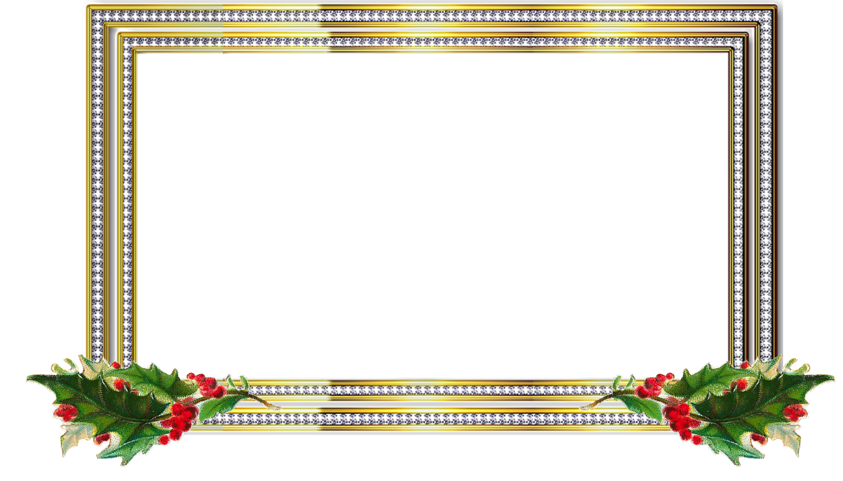
@JerryGodsey
#TwoKindsOfSeekers
Seeking A King
They are searching for a King
REMNANT
CHURCH
#AwkwardFamilyChristmas

Slide 13
@JerryGodsey
#TwoKindsOfSeekers
Seeking A King
There’s a big difference between King Herod and these Magi from the east…the Magi long to find Jesus…and Herod is disturbed when he hears about Him.
REMNANT
CHURCH
#AwkwardFamilyChristmas

Slide 14
@JerryGodsey
#TwoKindsOfSeekers
Seeking A King
Matthew 2:3-8
King Herod was deeply disturbed when he heard this, as was everyone in Jerusalem. ⁴ He called a meeting of the leading priests and teachers of religious law and asked, “Where is the Messiah
REMNANT
CHURCH
#AwkwardFamilyChristmas

Slide 15
@JerryGodsey
#TwoKindsOfSeekers
Seeking A King
Matthew 2:3-8
supposed to be born?”
⁵ “In Bethlehem in Judea,” they said, “for this is what the prophet wrote:
⁶ ‘And you, O Bethlehem in the land of Judah,
REMNANT
CHURCH
#AwkwardFamilyChristmas

Slide 16
@JerryGodsey
#TwoKindsOfSeekers
Seeking A King
Matthew 2:3-8
are not least among the ruling cities of Judah,
for a ruler will come from you
who will be the shepherd for my people Israel.’”
⁷ Then Herod called for a private
REMNANT
CHURCH
#AwkwardFamilyChristmas

Slide 17
@JerryGodsey
#TwoKindsOfSeekers
Seeking A King
Matthew 2:3-8
meeting with the wise men, and he learned from them the time when the star first appeared. ⁸ Then he told them, “Go to Bethlehem and search carefully for the child. And when you find him, come back and
REMNANT
CHURCH
#AwkwardFamilyChristmas

Slide 18
@JerryGodsey
#TwoKindsOfSeekers
Seeking A King
Matthew 2:3-8
tell me so that I can go and worship him, too!”
REMNANT
CHURCH
#AwkwardFamilyChristmas

Slide 19
@JerryGodsey
#TwoKindsOfSeekers
Seeking A King
Micah 5:2
But you, O Bethlehem Ephrathah, are only a small village among all the people of Judah. Yet a ruler of Israel, whose origins are in the distant past, will come from you on my behalf.
REMNANT
CHURCH
#AwkwardFamilyChristmas

Slide 20
@JerryGodsey
#TwoKindsOfSeekers
Seeking A King
Matthew 2:16-18
Herod was furious when he realized that the wise men had outwitted him. He sent soldiers to kill all the boys in and around Bethlehem who were two years old and under, based on the wise
REMNANT
CHURCH
#AwkwardFamilyChristmas

Slide 21
@JerryGodsey
#TwoKindsOfSeekers
Seeking A King
Matthew 2:16-18
men’s report of the star’s first appearance. ¹⁷ Herod’s brutal action fulfilled what God had spoken through the prophet Jeremiah:
¹⁸ “A cry was heard in Ramah—
REMNANT
CHURCH
#AwkwardFamilyChristmas

Slide 22
@JerryGodsey
#TwoKindsOfSeekers
Seeking A King
Matthew 2:16-18
weeping and great mourning. Rachel weeps for her children, refusing to be comforted, for they are dead.”
REMNANT
CHURCH
#AwkwardFamilyChristmas

Slide 23
@JerryGodsey
#TwoKindsOfSeekers
Seeking A King
Wise men and women searching to worship Him and Herod, the so called “Great” doing everything in his power to rid the world of Him.
REMNANT
CHURCH
#AwkwardFamilyChristmas

Slide 24
@JerryGodsey
#TwoKindsOfSeekers
Seeking A King
“A baby born in Bethlehem
His hands soft and gently curled
But held within his dimpled grasp the hope of all the world.”
REMNANT
CHURCH
#AwkwardFamilyChristmas

Slide 25
@JerryGodsey
#TwoKindsOfSeekers
This Special Star Belongs To Jesus
Matthew 2:9-11
After this interview the wise men went their way. And the star they had seen in the east guided them to Bethlehem. It went ahead of them and stopped over the place where the child was. ¹⁰ When they saw the star, they were filled with joy! ¹¹ They entered the
REMNANT
CHURCH
#AwkwardFamilyChristmas

Slide 26
@JerryGodsey
#TwoKindsOfSeekers
This Special Star Belongs To Jesus
Matthew 2:9-11
house and saw the child with his mother, Mary, and they bowed down and worshiped him. Then they opened their treasure chests and gave him gifts of gold, frankincense, and myrrh.
REMNANT
CHURCH
#AwkwardFamilyChristmas

Slide 27
@JerryGodsey
#TwoKindsOfSeekers
This Special Star Belongs To Jesus
Matthew 2:7
Then Herod called for a private meeting with the wise men, and he learned from them the time when the star first appeared.
REMNANT
CHURCH
#AwkwardFamilyChristmas

Slide 28
@JerryGodsey
#TwoKindsOfSeekers
This Special Star Belongs To Jesus
God was leading these people to
His Son
REMNANT
CHURCH
#AwkwardFamilyChristmas

Slide 29
@JerryGodsey
#TwoKindsOfSeekers
This Special Star Belongs To Jesus
Numbers 24:17
I see him, but not here and now. I perceive him, but far in the distant future. A star will rise from Jacob; a scepter will emerge from Israel…
REMNANT
CHURCH
#AwkwardFamilyChristmas

Slide 30
@JerryGodsey
#TwoKindsOfSeekers
This Special Star Belongs To Jesus
God got their attention with a star…and it led them to “the bright morning star.” The King of the Jews, but even more, it led them to The King of Kings.
REMNANT
CHURCH
#AwkwardFamilyChristmas

Slide 31
@JerryGodsey
#TwoKindsOfSeekers
This Special Star Belongs To Jesus
Matthew 2:11
They entered the house and saw the child with his mother, Mary, and they bowed down and worshiped him. Then they opened their treasure chests and gave him gifts of gold, frankincense, and myrrh.
REMNANT
CHURCH
#AwkwardFamilyChristmas

Slide 32
@JerryGodsey
#TwoKindsOfSeekers
This Special Star Belongs To Jesus
Gold pointed to His majesty…
REMNANT
CHURCH
#AwkwardFamilyChristmas

Slide 33
@JerryGodsey
#TwoKindsOfSeekers
This Special Star Belongs To Jesus
Frankincense pointed to His deity…
REMNANT
CHURCH
#AwkwardFamilyChristmas

Slide 34
@JerryGodsey
#TwoKindsOfSeekers
This Special Star Belongs To Jesus
Myrrh pointed to His humanity…
REMNANT
CHURCH
#AwkwardFamilyChristmas

Slide 35
@JerryGodsey
#TwoKindsOfSeekers
God arranged it so that their gifts to the King in the cradle would point us to who Jesus really is and why He came
REMNANT
CHURCH
#AwkwardFamilyChristmas

Slide 36
@JerryGodsey
#TwoKindsOfSeekers
REMNANT
CHURCH
#AwkwardFamilyChristmas

