Slide 2
#CoolStoryBro
REMNANT
CHURCH
Wednesdays at 10AM on our channel.

Slide 3
#CoolStoryBro
REMNANT
CHURCH
Dinner
Time!

Slide 4
# DinnerTime
REMNANT
CHURCH
Jesus spoke in the language of parables. Using crystal-clear metaphors and provocatively simple stories Jesus described what the Kingdom was like. His most impassioned speeches were no more than common agricultural truisms, basic stories about seeds and manure and sheep, innocent stories laced with razor-sharp truth.
Don Everts- “Jesus With Dirty Feet”
@JerryGodsey
#CoolStoryBro

Slide 5
# TheFWord
REMNANT
CHURCH
The Setting
Luke 14:7
When Jesus noticed that all who had come to the dinner were trying to sit in the seats of honor near the head of the table, he gave them this advice:
@JerryGodsey
#CoolStoryBro

Slide 6
# TheFWord
REMNANT
CHURCH
The Setting
Luke 14:8-11
⁸ “When you are invited to a wedding feast, don’t sit in the seat of honor. What if someone who is more distinguished than you has also been invited? ⁹ The host will come and say, ‘Give this person your seat.’ Then you will be embarrassed, and you will have to take whatever seat is left at the foot of the table!
@JerryGodsey
#CoolStoryBro

Slide 7
# TheFWord
REMNANT
CHURCH
The Setting
Luke 14:8-11
¹⁰ “Instead, take the lowest place at the foot of the table. Then when your host sees you, he will come and say, ‘Friend, we have a better place for you!’ Then you will be honored in front of all the other guests. ¹¹ For those who exalt themselves will be humbled, and those who humble themselves will be exalted.”
@JerryGodsey
#CoolStoryBro

Slide 8
# TheFWord
REMNANT
CHURCH
The Setting
Luke 14:12-14
Then he turned to his host. “When you put on a luncheon or a banquet,” he said, “don’t invite your friends, brothers, relatives, and rich neighbors. For they will invite you back, and that will be your only reward. ¹³ Instead, invite the poor, the crippled, the lame, and the blind. ¹⁴ Then at the resurrection of the righteous, God will reward you for inviting those who could not repay you.”
@JerryGodsey
#CoolStoryBro

Slide 9
# DinnerTime
REMNANT
CHURCH
The Story
Luke 14:16-17
Jesus replied with this story: “A man prepared a great feast and sent out many invitations. ¹⁷ When the banquet was ready, he sent his servant to tell the guests, ‘Come, the banquet is ready.’
@JerryGodsey
#CoolStoryBro

Slide 10
# DinnerTime
REMNANT
CHURCH
The Story
Luke 14:18
But they all began making excuses. One said, ‘I have just bought a field and must inspect it. Please excuse me.’
@JerryGodsey
#CoolStoryBro

Slide 11
# DinnerTime
REMNANT
CHURCH
The Story
Luke 14:19
Another said, ‘I have just bought five pairs of oxen, and I want to try them out. Please excuse me.’
@JerryGodsey
#CoolStoryBro

Slide 12
# DinnerTime
REMNANT
CHURCH
The Story
Luke 14:20
Another said, ‘I just got married, so I can’t come.’
@JerryGodsey
#CoolStoryBro

Slide 13
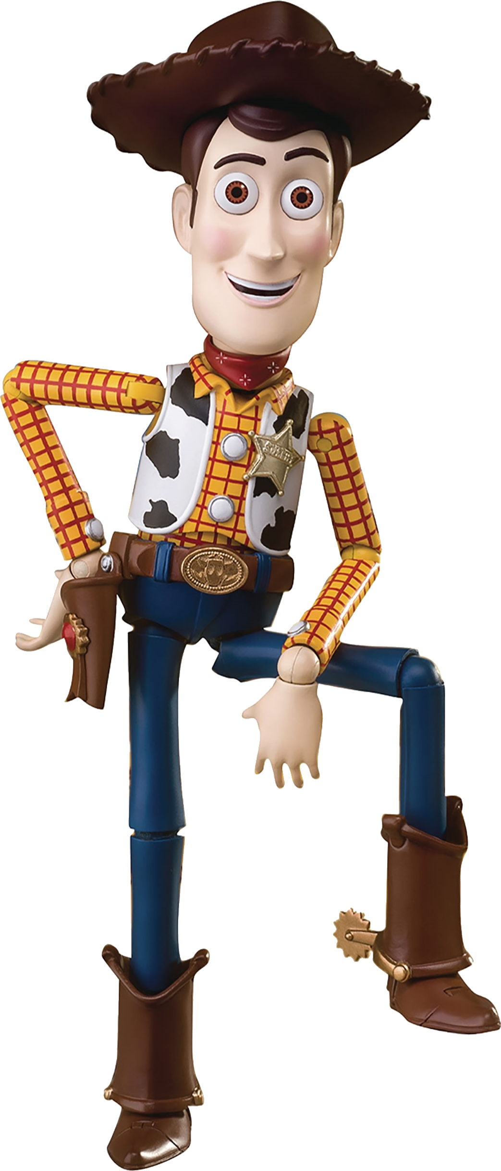
# DinnerTime
REMNANT
CHURCH
By not keeping his commitments and not attending the party, he was dishonoring the host.

Slide 14
# DinnerTime
REMNANT
CHURCH
The Story
Luke 14:21-24
“The servant returned and told his master what they had said. His master was furious and said, ‘Go quickly into the streets and alleys of the town and invite the poor, the crippled, the blind, and the lame.’ ²² After the servant had done this, he reported, ‘There is still room for more.’
@JerryGodsey
#CoolStoryBro

Slide 15
# DinnerTime
REMNANT
CHURCH
The Story
Luke 14:21-24
²³ So his master said, ‘Go out into the country lanes and behind the hedges and urge anyone you find to come, so that the house will be full. ²⁴ For none of those I first invited will get even the smallest taste of my banquet.’”
@JerryGodsey
#CoolStoryBro

Slide 16
# DinnerTime
REMNANT
CHURCH
The Stinger
You cannot put anything in the place of God.
@JerryGodsey
#CoolStoryBro

Slide 17
# DinnerTime
REMNANT
CHURCH
The Stinger
Unfortunately, we do the same thing.
@JerryGodsey
#CoolStoryBro

Slide 18
# DinnerTime
REMNANT
CHURCH
"He is no fool to give up what he cannot keep to gain what he cannot lose."
Jim Elliot

Slide 19
# DinnerTime
REMNANT
CHURCH
"Everything else can wait, but the search for God cannot”
George Harrison

Slide 20
# DinnerTime
REMNANT
CHURCH
The Takeaway
John 3:16-17
“For this is how God loved the world: He gave his one and only Son, so that everyone who believes in him will not perish but have eternal life. ¹⁷ God sent his Son into the world not to judge the world, but to save the world through him.
@JerryGodsey
#CoolStoryBro

Slide 21
# TheFWord
REMNANT
CHURCH
With being a child of the king also comes some responsibilities.

Slide 22
# TheFWord
REMNANT
CHURCH
The Takeaway
Mark 16:15
Go into all the world and preach the Good News to everyone.
@JerryGodsey
#CoolStoryBro

Slide 23
# DinnerTime
REMNANT
CHURCH
Jesus didn't intend His church merely to provide bigger and better amusement for bigger and more upscale audiences. His vision was of a church that would inject His light and life into a dark and dying world. So we better take the vision of Jesus seriously, or we won't just be amusing ourselves to death. We'll be amusing people to hell.

Slide 24
Thank You
For Joining Us!

Slide 25
If this worship experience has touched your life, or if you would like more information about Remnant Church, please visit our website remnantchurchiv.com and leave us a message.

Slide 26
…and don’t forget to like this video and subscribe to our channel!

