Slide 1
#whenallhopeislost
WHEN ALL HOPE IS LOST
@JerryGodsey
REMNANT
CHURCH

Slide 2
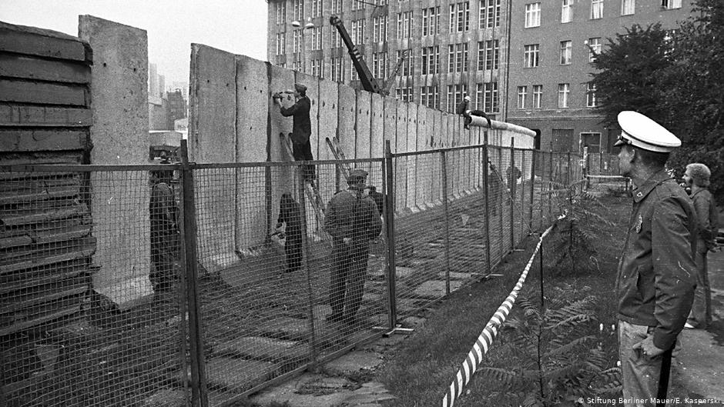
#whenallhopeislost
REMNANT
CHURCH
@JerryGodsey

Slide 3
#whenallhopeislost
REMNANT
CHURCH
@JerryGodsey

Slide 4
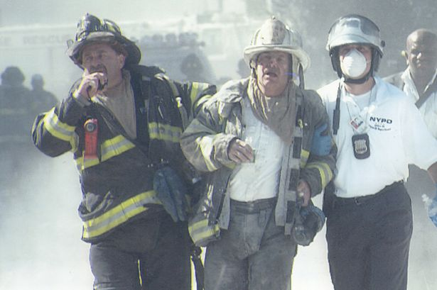
#whenallhopeislost
REMNANT
CHURCH
@JerryGodsey

Slide 5
#whenallhopeislost
REMNANT
CHURCH
@JerryGodsey

Slide 6
#findingpeace
“
The world has changed, but Easter hasn’t.
”
REMNANT
CHURCH
@JerryGodsey

Slide 7
#whenallhopeislost
Matthew 28:1-10
Early on Sunday morning, as the new day was dawning, Mary Magdalene and the other Mary went out to visit the tomb.
² Suddenly there was a great earthquake! For an angel of the Lord came down from heaven, rolled aside the stone, and sat on it. ³ His face shone like lightning, and his clothing was as white as snow.
REMNANT
CHURCH
@JerryGodsey

Slide 8
#whenallhopeislost
Matthew 28:1-10
⁴ The guards shook with fear when they saw him, and they fell into a dead faint.
⁵ Then the angel spoke to the women. “Don’t be afraid!” he said. “I know you are looking for Jesus, who was crucified. ⁶ He isn’t here! He is risen from the dead, just as he said would happen. Come, see where his body was lying.
REMNANT
CHURCH
@JerryGodsey

Slide 9
#whenallhopeislost
Matthew 28:1-10
⁷ And now, go quickly and tell his disciples that he has risen from the dead, and he is going ahead of you to Galilee. You will see him there. Remember what I have told you.”
⁸ The women ran quickly from the tomb. They were very frightened but also filled with great joy, and they rushed to give the disciples the angel’s message
REMNANT
CHURCH
@JerryGodsey

Slide 10
#whenallhopeislost
Matthew 28:1-10
⁹ And as they went, Jesus met them and greeted them. And they ran to him, grasped his feet, and worshiped him. ¹⁰ Then Jesus said to them, “Don’t be afraid! Go tell my brothers to leave for Galilee, and they will see me there.”
REMNANT
CHURCH
@JerryGodsey

Slide 11
#findingpeace
“
The defining moment of our lives is not the Berlin Wall, 9-11 or COVID 19. The defining moment of our lives is Easter Sunday--the resurrection of Jesus Christ.
”
REMNANT
CHURCH
@JerryGodsey

Slide 12
#whenallhopeislost
STAND UP TO YOUR FEARS
REMNANT
CHURCH
@JerryGodsey

Slide 13
#whenallhopeislost
STAND UP TO YOUR FEARS
“Don’t be afraid…”
Matthew 28:10
REMNANT
CHURCH
@JerryGodsey

Slide 14
#whenallhopeislost
STAND UP TO YOUR FEARS
Jesus is not referring to our emotions as much as he is referring to our thoughts and actions. He's saying, "Do not think fearfully; do not act fearfully."
REMNANT
CHURCH
@JerryGodsey

Slide 15
#whenallhopeislost
STAND UP TO YOUR FEARS
O LORD, how long will this go on? Will you hide yourself forever? How long will your anger burn like fire?
Psalm 89:46
REMNANT
CHURCH
@JerryGodsey

Slide 16
#whenallhopeislost
STAND UP TO YOUR FEARS
And be sure of this: I am with you always, even to the end of the age
Matthew 28:20
REMNANT
CHURCH
@JerryGodsey

Slide 17
#findingpeace
STAND UP TP YPUR FEARS
“
Fear is just a feeling, and we no longer have to live by our feelings; we can live by faith.
”
REMNANT
CHURCH
@JerryGodsey

Slide 18
#whenallhopeislost
FOCUS ON YOUR MISSION
REMNANT
CHURCH
@JerryGodsey

Slide 19
#whenallhopeislost
FOCUS ON YOUR MISSION
Don’t be afraid! Go tell my brothers to leave for Galilee, and they will see me there.
Matthew 28:10
REMNANT
CHURCH
@JerryGodsey

Slide 20
#whenallhopeislost
FOCUS ON YOUR MISSION
Therefore, go and make disciples of all the nations, baptizing them in the name of the Father and the Son and the Holy Spirit. 20 Teach these new disciples to obey all the commands I have given you.
Matthew 28:19-20
REMNANT
CHURCH
@JerryGodsey

Slide 21
#whenallhopeislost
FOCUS ON YOUR MISSION
And then he told them, “Go into all the world and preach the Good News to everyone.
Mark 16:15
REMNANT
CHURCH
@JerryGodsey

Slide 22
#whenallhopeislost
FOCUS ON YOUR MISSION
"...repentance and forgiveness of sins will be preached in his name to all nations...“
Luke 24:47(NIV)
REMNANT
CHURCH
@JerryGodsey

Slide 23
#whenallhopeislost
FOCUS ON YOUR MISSION
Again he said, “Peace be with you. As the Father has sent me, so I am sending you.
John 20:21
REMNANT
CHURCH
@JerryGodsey

Slide 24
#findingpeace
FOCUS ON YOUR MISSION
“
We've got a great story to tell, and the world desperately needs to hear it.
”
REMNANT
CHURCH
@JerryGodsey

Slide 25
#whenallhopeislost
RELY ON GOD’S PROMISES
REMNANT
CHURCH
@JerryGodsey

Slide 26
#whenallhopeislost
RELY ON GOD’S PROMISES
Don’t be afraid! Go tell my brothers to leave for Galilee, and they will see me there.
Matthew 28:10
REMNANT
CHURCH
@JerryGodsey

Slide 27
#whenallhopeislost
RELY ON GOD’S PROMISES
“
Remnant’s hope is not in our social ministries, our programs, or anything else that we do. Our hope is in the power of Jesus Christ to change lives.
”
REMNANT
CHURCH
@JerryGodsey

Slide 28
#whenallhopeislost
RELY ON GOD’S PROMISES
Give your life to Jesus Christ, and he will turn it around.
Give your heart to him and he will fill it with his presence.
Give your burdens to him, and he will carry them.
REMNANT
CHURCH
@JerryGodsey

Slide 29
#whenallhopeislost
RELY ON GOD’S PROMISES
Confess your sins to him and he will forgive you, absolutely and completely.
Give him your sorrow, your fear, your broken dreams, your worries, and he will replace them with joy and peace and love and fulfillment.
REMNANT
CHURCH
@JerryGodsey

Slide 30
#findingpeace
RELY ON GOD’S PROMISES
“
These are bold promises to make, but I make them without hesitation, because I know that I can rely on the promises of Jesus.
”
REMNANT
CHURCH
@JerryGodsey

Slide 31
#findingpeace
RELY ON GOD’S PROMISES
“
Without the promises of Jesus, the church doesn't have much to offer the world--if anything at all.
”
REMNANT
CHURCH
@JerryGodsey

Slide 32
#whenallhopeislost
RELY ON GOD’S PROMISES
We couldn't offer joyful fellowship, because he's our source of joy; without his promises, our joy wouldn't exist.
REMNANT
CHURCH
@JerryGodsey

Slide 33
#whenallhopeislost
RELY ON GOD’S PROMISES
We couldn't offer social ministries, because those ministries are operated by people whose lives have been changed his power.
Without his promises, those lives would never have been changed, and those ministries wouldn't exist.
REMNANT
CHURCH
@JerryGodsey

Slide 34
#whenallhopeislost
RELY ON GOD’S PROMISES
We couldn't open our doors for public services, because without his promises, there are no songs to sing and no message to preach.
REMNANT
CHURCH
@JerryGodsey

Slide 35
#whenallhopeislost
FOCUS ON YOUR MISSION
Therefore, go and make disciples of all the nations, baptizing them in the name of the Father and the Son and the Holy Spirit. 20 Teach these new disciples to obey all the commands I have given you.
Matthew 28:19-20
REMNANT
CHURCH
@JerryGodsey

Slide 36
#whenallhopeislost
FOCUS ON YOUR MISSION
And then he told them, “Go into all the world and preach the Good News to everyone.
Mark 16:15
REMNANT
CHURCH
@JerryGodsey

Slide 37
#whenallhopeislost
FOCUS ON YOUR MISSION
"...repentance and forgiveness of sins will be preached in his name to all nations...“
Luke 24:47(NIV)
REMNANT
CHURCH
@JerryGodsey

Slide 38
#whenallhopeislost
FOCUS ON YOUR MISSION
Again he said, “Peace be with you. As the Father has sent me, so I am sending you.
John 20:21
REMNANT
CHURCH
@JerryGodsey

Slide 39
#whenallhopeislost
“
As we face uncertain times, we can no longer afford to put our trust in ourselves, or in our economy, or in our company, or in our country, or in anyone else.
Our only hope is to put our hope only in him.
”
REMNANT
CHURCH
@JerryGodsey

Slide 40
#whenallhopeislost
REMNANT
CHURCH
@JerryGodsey

