Slide 1
#THEOLDTRICK
@JEREMIAHVIK
THE OLD TRICK
PROVERBS 14:12-18
#GETSMART
REMNANT
CHURCH

Slide 2
#THEOLDTRICK
@JEREMIAHVIK
Get Smart
video clip
“The Old _ Trick” 1965 – CBS Prod
#GETSMART
REMNANT
CHURCH

Slide 3
#THEOLDTRICK
@JEREMIAHVIK
MOST OF THE DECISIONS THAT WE MAKE ARE MADE FROM THE GUT OR BY RELYING ON A FEELING.
#GETSMART
REMNANT
CHURCH

Slide 4
#THEOLDTRICK
@JEREMIAHVIK
The ability to think and act using knowledge, experience, understanding, common sense and insight.
WISDOM:
Loading...
The ability to perceive something based on instinctive feeling rather than conscious reasoning.
INTUITION:
#GETSMART
REMNANT
CHURCH

Slide 5
#THEOLDTRICK
@JEREMIAHVIK
• Intuition is you talking to you.
• Intuition is your feelings + your thoughts.
• Intuition is not always a good thing.
• Intuition must have guidelines.
THINGS YOU NEED TO KNOW ABOUT INTUITION
#GETSMART
REMNANT
CHURCH

Slide 6
#THEOLDTRICK
@JEREMIAHVIK
Proverbs 14:12-18
¹² There is a path that seems right to a person, but in the end, it leads to death. ¹³ Laughter can conceal a heavy heart, but when the laughter ends, the grief remains. ¹⁴ Backsliders get what they deserve; good people receive their reward. ¹⁵ Only fools simply believe everything they’re told! The prudent carefully consider their steps. ¹⁶ The wise are cautious and avoid danger; fools plunge ahead with reckless confidence. ¹⁷ Short-tempered people do
#GETSMART
REMNANT
CHURCH

Slide 7
#THEOLDTRICK
@JEREMIAHVIK
Proverbs 14:12-18
foolish things, and schemers are hated. ¹⁸ Simpletons are clothed with foolishness, but the prudent are crowned with knowledge.
#GETSMART
REMNANT
CHURCH

Slide 8
#THEOLDTRICK
@JEREMIAHVIK
Vs. 12
There is a path that seems right to a person, but in the end, it leads to death.
#GETSMART
REMNANT
CHURCH

Slide 9
#THEOLDTRICK
@JEREMIAHVIK
WE CANNOT TRUST OUR FEELINGS
Jeremiah 17:9
The human heart is deceitful above all things, and desperately sick; who can understand it?
#GETSMART
REMNANT
CHURCH

Slide 10
#THEOLDTRICK
@JEREMIAHVIK
WE CANNOT TRUST OUR FEELINGS
OUR FEELINGS CAN’T ALWAYS BE TRUSTED BECAUSE THEY ARE CONSTANTLY DRIVEN BY OUR DESIRE TO PLEASE OURSELVES.
#GETSMART
REMNANT
CHURCH

Slide 11
#THEOLDTRICK
@JEREMIAHVIK
WE CANNOT TRUST OUR FEELINGS
“All men seek happiness. This is without exception. Whatever different means they employ, they all tend to this end. The cause of some going to war, and of others avoiding it, is the same desire in both, attended with
#GETSMART
REMNANT
CHURCH

Slide 12
#THEOLDTRICK
@JEREMIAHVIK
WE CANNOT TRUST OUR FEELINGS
different views. The will never takes the least step but to this object. This is the motive of every action of every man, even of those who hang themselves.”
-Blaise Pascal
#GETSMART
REMNANT
CHURCH

Slide 13
#THEOLDTRICK
@JEREMIAHVIK
WE CANNOT TRUST OUR FEELINGS
The belief that seeking pleasure and avoiding suffering are the only components of well-being.
HEDONISM:
#GETSMART
REMNANT
CHURCH

Slide 14
#THEOLDTRICK
@JEREMIAHVIK
WE CANNOT TRUST OUR FEELINGS
EVERY DECISION YOU MAKE HAS AT ITS CORE YOUR OWN HAPPINESS. THERE IS NO DECISION YOU MAKE THAT IS CONTRARY TO THAT.
#GETSMART
REMNANT
CHURCH

Slide 15
#THEOLDTRICK
@JEREMIAHVIK
WE CANNOT TRUST OUR FEELINGS
2 Timothy 3:2-4
For people will be lovers of self, lovers of money, proud, arrogant, abusive, disobedient to their parents, ungrateful, unholy, heartless, unappeasable, slanderous, without self-control, brutal, not loving good, treacherous, reckless, swollen with conceit, lovers of pleasure rather than lovers of God.
#GETSMART
REMNANT
CHURCH

Slide 16
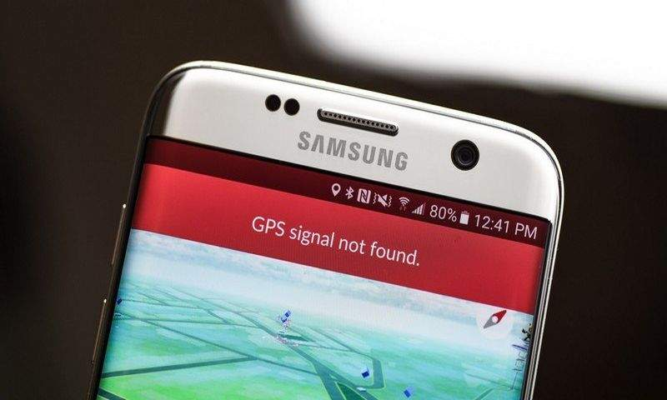
#THEOLDTRICK
@JEREMIAHVIK
WE CANNOT TRUST OUR FEELINGS
GPS Signal Lost.
Must be an Android problem
#GETSMART
REMNANT
CHURCH

Slide 17
#THEOLDTRICK
@JEREMIAHVIK
WE CANNOT TRUST OUR FEELINGS
OUR INTUITION IS OFTEN OFF BECAUSE IT IS DRIVEN BY OUR FEELINGS INSTEAD OF GOD’S TRUTH.
#GETSMART
REMNANT
CHURCH

Slide 18
#THEOLDTRICK
@JEREMIAHVIK
Vs. 15
Only fools simply believe everything they’re told! The prudent carefully consider their steps.
#GETSMART
REMNANT
CHURCH

Slide 19
#THEOLDTRICK
@JEREMIAHVIK
WE CAN’T ALWAYS GO BY WHAT ‘SOUNDS GOOD’
WHAT MAKES DECISION-MAKING BASED ON INTUITION SO DANGEROUS, IS THAT IT ALWAYS SOUNDS SO RIGHT.
#GETSMART
REMNANT
CHURCH

Slide 20
#THEOLDTRICK
@JEREMIAHVIK
WE CAN’T ALWAYS GO BY WHAT ‘SOUNDS GOOD’
Matthew 16:15-17
¹⁵Then he asked them, “But who do you say I am?” ¹⁶Simon Peter answered, “You are the Messiah, the Son of the living God.” ¹⁷Jesus replied, “You are blessed, Simon son of John, because my Father in heaven has revealed this to you. You did not learn this from any human being.
#GETSMART
REMNANT
CHURCH

Slide 21
#THEOLDTRICK
@JEREMIAHVIK
WE CAN’T ALWAYS GO BY WHAT ‘SOUNDS GOOD’
Matthew 16:21-23
²¹From then on Jesus began to tell his disciples plainly that it was necessary for him to go to Jerusalem, and that he would suffer many terrible things at the hands of the elders, the leading priests, and the teachers of religious law. He would be killed, but on the third day he would be raised from the dead. ²²But Peter took him aside and
#GETSMART
REMNANT
CHURCH

Slide 22
#THEOLDTRICK
@JEREMIAHVIK
WE CAN’T ALWAYS GO BY WHAT ‘SOUNDS GOOD’
Matthew 16:21-23
began to reprimand him for saying such things. “Heaven forbid, Lord,” he said. “This will never happen to you!” ²³Jesus turned to Peter and said, “Get behind me, Satan! You are a dangerous trap to me. You are seeing things merely from a human point of view, not from God’s.”
#GETSMART
REMNANT
CHURCH

Slide 23
#THEOLDTRICK
@JEREMIAHVIK
WE CAN’T ALWAYS GO BY WHAT ‘SOUNDS GOOD’
WHEN WE LISTEN TO OUR INTUITION ALONE, WE ARE OFTEN IGNORING WHAT WE DON’T WANT TO HEAR.
#GETSMART
REMNANT
CHURCH

Slide 24
#THEOLDTRICK
@JEREMIAHVIK
WE CAN’T ALWAYS GO BY WHAT ‘SOUNDS GOOD’
2 Timothy 4:3-4
The time is coming when people won’t listen to good teaching. Instead, they will look for teachers who will please them by telling them only what they are itching to hear. They will turn from the truth and eagerly listen to senseless stories.
#GETSMART
REMNANT
CHURCH

Slide 25
#THEOLDTRICK
@JEREMIAHVIK
Vs. 16
The wise are cautious and avoid danger; fools plunge ahead with reckless confidence.
#GETSMART
REMNANT
CHURCH

Slide 26
#THEOLDTRICK
@JEREMIAHVIK
Fail
video clip
“Reckless Confidence”
#GETSMART
REMNANT
CHURCH

Slide 27
#THEOLDTRICK
@JEREMIAHVIK
WE NEED TO EXERCISE GODLY CAUTION
WHEN WE ARE MORE INFLUENCED BY OUR FEELINGS THAN BY GOD’S WORD, THE MORE RECKLESS OUR DECISION-MAKING BECOMES.
#GETSMART
REMNANT
CHURCH

Slide 28
#THEOLDTRICK
@JEREMIAHVIK
WE NEED TO EXERCISE GODLY CAUTION
UNDIVIDED LOYALTY
James 1:8
A double-minded person is unstable in all their ways.
This kind of person can’t make up their mind. They can never decide what to do. (NIRV)
#GETSMART
REMNANT
CHURCH

Slide 29
#THEOLDTRICK
@JEREMIAHVIK
WE NEED TO EXERCISE GODLY CAUTION
GODLY DECISION-MAKING REQUIRES THAT WE RECALIBRATE OUR THINKING TO LINE UP WITH GOD’S TRUTH.
#GETSMART
REMNANT
CHURCH

Slide 30
#THEOLDTRICK
@JEREMIAHVIK
WE NEED TO EXERCISE GODLY CAUTION
2 Timothy 3:16
All Scripture is inspired by God and is useful to teach us what is true and to make us realize what is wrong in our lives. It corrects us when we are wrong and teaches us to do what is right.
#GETSMART
REMNANT
CHURCH

Slide 31
#THEOLDTRICK
@JEREMIAHVIK
WE NEED TO EXERCISE GODLY CAUTION
THEOLOGICALLY INFORMED LIVING
2 Timothy 3:17
God uses it (SCRIPTURE) to prepare and equip his people to do every good work.
#GETSMART
REMNANT
CHURCH

Slide 32
#THEOLDTRICK
@JEREMIAHVIK
WE NEED TO EXERCISE GODLY CAUTION
WHEN WE ALLOW GOD’S TRUTH TO INFORM OUR DECISION-MAKING PROCESS, WE BEGIN TO MAKE BETTER CHOICES FOR OUR LIVES AND HONOR HIM ALONG THE WAY.
#GETSMART
REMNANT
CHURCH

Slide 33
#THEOLDTRICK
@JEREMIAHVIK
WE NEED TO EXERCISE GODLY CAUTION
Proverbs 4:23
Above all else, guard your affections. For they influence everything else in your life.
#GETSMART
REMNANT
CHURCH

Slide 34
#THEOLDTRICK
@JEREMIAHVIK
WE NEED TO EXERCISE GODLY CAUTION
GODLY DECISION-MAKING DOESN’T MEAN WE COMPLETELY DISREGARD OUR FEELINGS, BUT WE USE THEM MORE AS GAUGES THAN GUIDES.
#GETSMART
REMNANT
CHURCH

Slide 35
#THEOLDTRICK
@JEREMIAHVIK
#GETSMART
REMNANT
CHURCH

